Slide 1
ADHD & Productivity Course
Dr. James Brown
Week 4
Session begins at 6pm
Follow us!
@seedtalks

Slide 3
WEEK 4. Managing Distractions.
November 20th 2023
Dr James Brown

Slide 4
Week | Topic | Information
1 | Understanding ADHD and motivation. | Why does ADHD create a barrier to productivity
2 | Tackling procrastination and perfectionism. | How to start to accept that perfection is a barrier to progress, and takling the sources of procrastination
3 | Engaging with and completing tasks. | Understanding why 'starting' and finishing' can be an issue, and discussing approaches to tackle this
4 | Managing your distractions. | How to create a work environment that removes unnecessary distractions
5 | Building routines | Developing routines for the start pf day, work activities and end of day
6 | Managing stress and burnout. | Stress and burnout impact productivity. How can we prevent this?

Slide 5
Time | Section | Content
5 minutes | Introductions | Last week’s form response and discuss how the session will run
30 minutes | Discussion 1 | Why are we easily distracted?
5 minutes | Break | Time for a cuppa
20 minutes | Discussion 2 | What are the challenges and impacts of for distractibility?
5 minutes | Break | Time to stretch our legs
35 minutes | Discussion 3 | Tactics managing distractions with ADHD.
10 minutes | Summary and next steps | What will you do next?
Today…

Slide 6
Learning Objectives
Upon completion of this session, learners will be able to:
Learn to recognize common distractions that individuals with ADHD often face in their daily lives.
Develop self-awareness about your own unique ADHD-related challenges and how distractions manifest for them personally
Identify and discuss strategies for managing distractions and time management with ADHD.

Slide 7
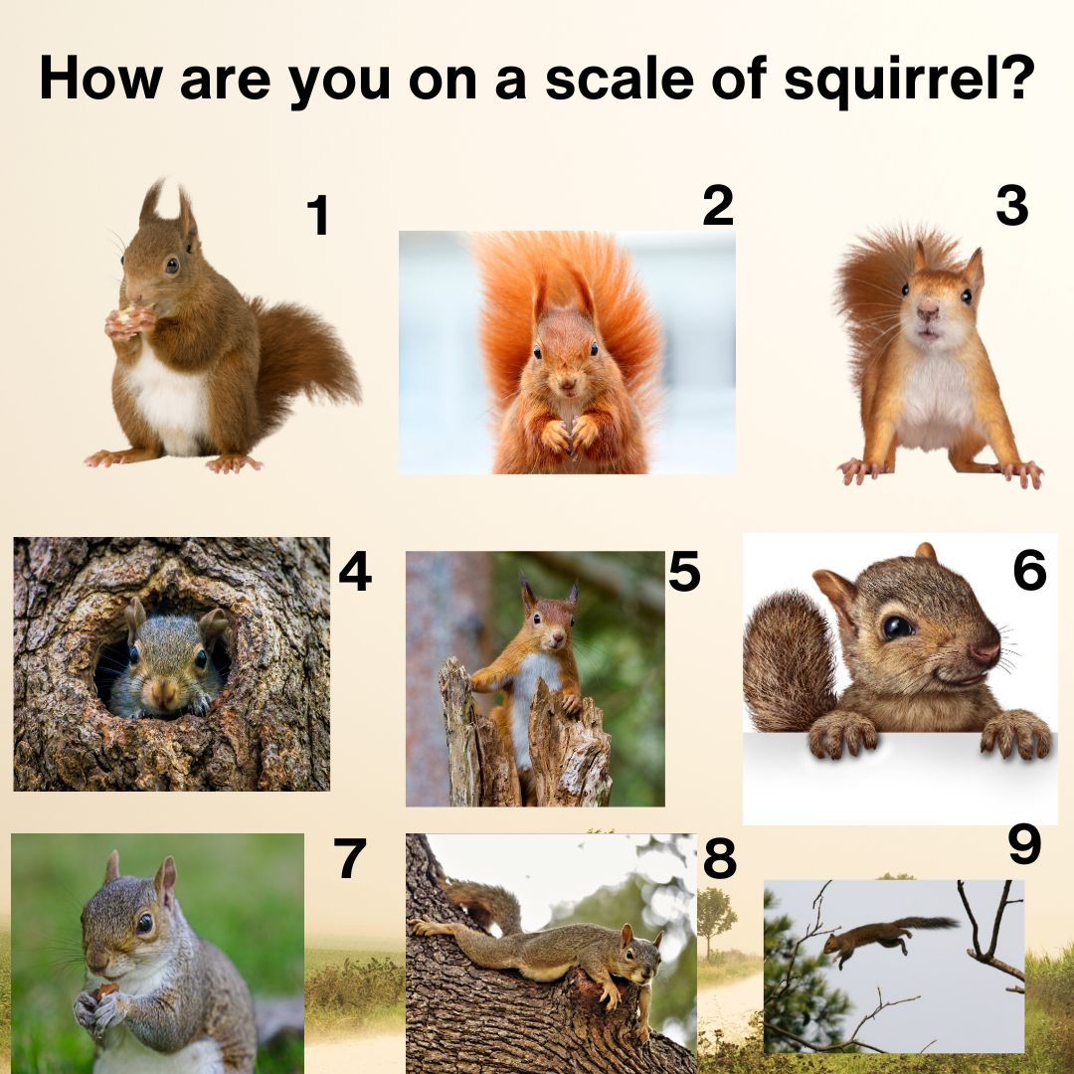
Icebreaker

Slide 8
Results from last week‘s poll - distractions
Phone
Thoughts
Notifications
Clutter
Other people
Sensory things

Slide 9
Results from last week‘s poll - consqequences
Takes longer to do stuff
Time wasted
Lose focus

Slide 10
Discussion 1.
Why are we distractible and what are distractions?

Slide 11
The Most common Distractions
The Internet: 41%,
Gossip: 39%,
Social media: 37%,
Co-workers: 27%,
Smoke breaks or snack breaks: 27%,
Emails: 26%,
Meetings: 24%,
Noisy co-workers: 20%.
Sitting in a cubicle: 9%.

Slide 12
Write your answer in the chat…
Discussion 1a.
External distractions
What are your digital distractions?

Slide 13
Write your answer in the chat…
Discussion 1b.
External distractions
What are your physical distractions?

Slide 14
Write your answer in the chat…
Discussion 1c.
External distractions
What are your internal distractions?

Slide 15
ADHD and Distractions
External distractions.
Internal distractions
Unwanted intrusive thoughts.
Spontaneous mind-wandering
Q – which is the strongest?

Slide 16
External Distractions

Slide 17
Dopamine
Q – is dopamine seeking always about ‘a rush’?

Slide 18
Reward-Based Distractions
Anything more ‘rewarding’ than your task.
Usually immediate, not aversive.

Slide 19
External Distractions
Immediate Aversive
Q – which one of these is dopamine based?

Slide 20
Sensory Stimulation
Q – what external sensory stimuli can immediately distract you

Slide 21
Our brains lack an appropriate ‘filter’

Slide 22
Internal Distractions

Slide 23
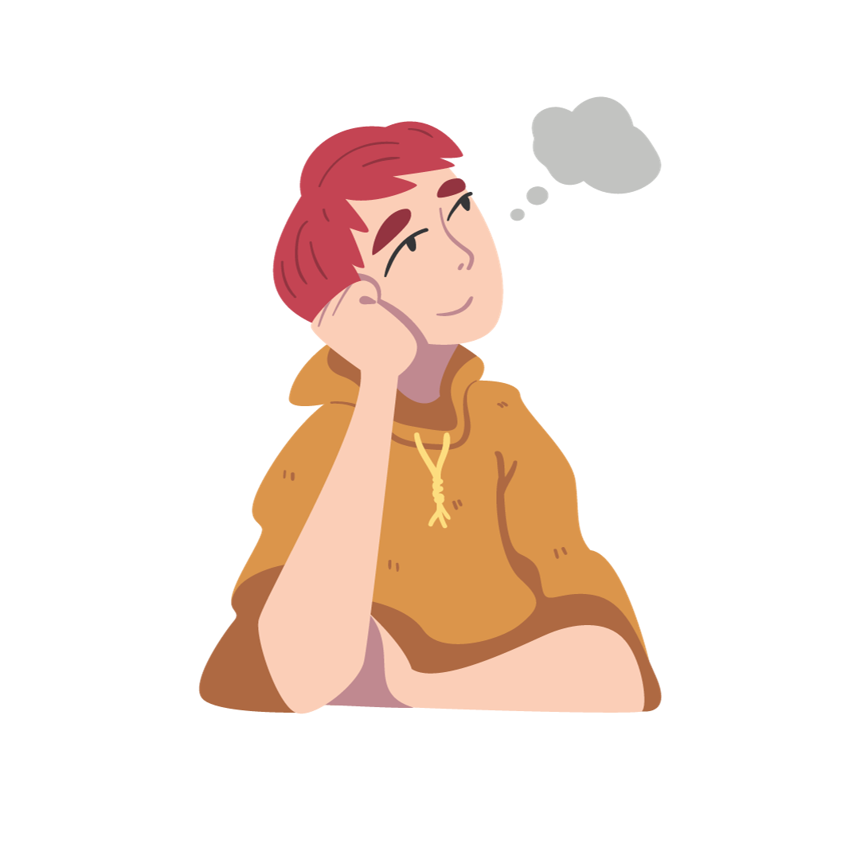
Internal Distractions
Mind wandering Racing thoughts

Slide 24
Why?
Lack of ‘inhibitory control’

Slide 25
Time for a break…

Slide 26
Write your answer in the chat…
Discussion 2.
How does distractibility impct you?

Slide 27
Impact of Distractibility
Reduced Productivity.
Difficulty in Organisation.
Strained Relationships.
Safety Concerns.
Academic and Career Challenges.
Stress and Anxiety.
Procrastination.
Financial Consequences.
Impaired Driving Skills.
QoL.

Slide 28
Distractibility
In general population…

Slide 29
Distractions and Working Memory
Poorer working memory leads to a lower ability to avoid distractions.

Slide 30
Distractions and Time Blindness
Time blindness (mostly perception of time) is exacerbated by distractions.

Slide 31
Multi-tasking and Distractions
Many of us can multi-task…
Initially might help, but then…. Nope!
But it increases distractibility, decreases productivity and IQ!

Slide 32
Stress and Distractions
Distraction soothes anxiety (initially)
Long-term, it drives anxiety and stress.

Slide 33
Distractions and Procrastination
Distractions fuel procrastination…

Slide 34
Time for another break…

Slide 35
Write your answer in the chat…
Discussion 3.
How can we manage our distractions?

Slide 36
Environment is EVERYTHING!
Well, almost everything

Slide 37
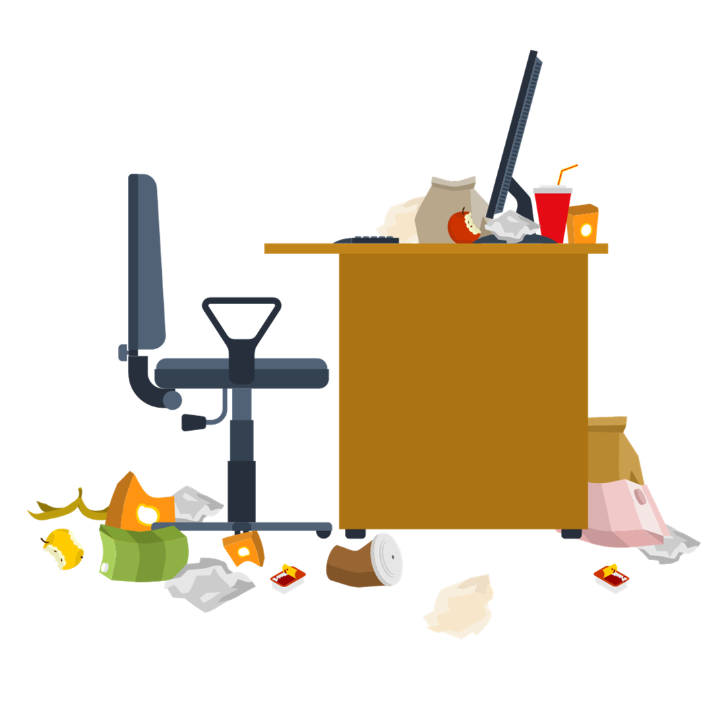
Your Environment Matters…

Slide 38
1. Workplace/workstation
Q – what does your workstation look more like?
A
B

Slide 39
1. Workplace/workstation
Right location (if possible).
Limit clutter and choose motivational personalisation.
Desk layout (everything in reach).
Comfort.
Limits screens.
Close window blinds/curtains.

Slide 40
2. Colleagues.

Slide 41
2. Colleagues – Office based

Slide 42
2. Colleagues – electronic

Slide 43
3. Digital

Slide 44
3. Digital - Computers
StayFocusd (Chrome Extension).
Cold Turkey.
Freedom.
Focus@Will.
RescueTime.
Lazar Focus (Microsoft).

Slide 45
3. Digital - Phones
Forest.
Flipd.
AppBlock.
Freedom (mobile version).
Space.
StayFocusd (mobile version).

Slide 46
4. Sensory
Not just

Slide 47
5. Internal Distractions

Slide 48
Week 4 Summary
ADHD has distractibility as a core trait for most.
Distractions can be internal or external.
Mind wandering could be the biggest distraction.
Manage your physical and digital space to out barriers in place for distractions.

Slide 49
Non-compulsory “Homework”
List the things that distract you.
Self-test: test your knowledge from Week 3

Slide 50
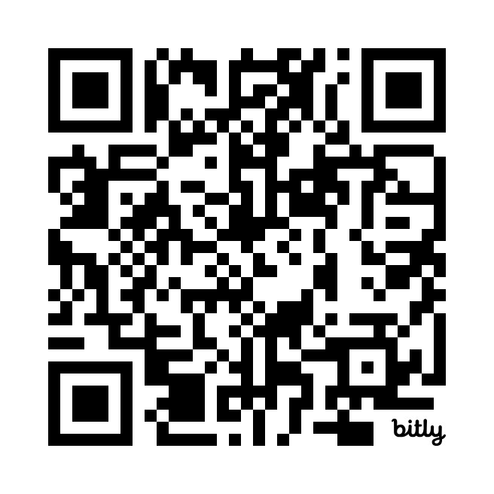
Link to Preparation for Week 5

Slide 51
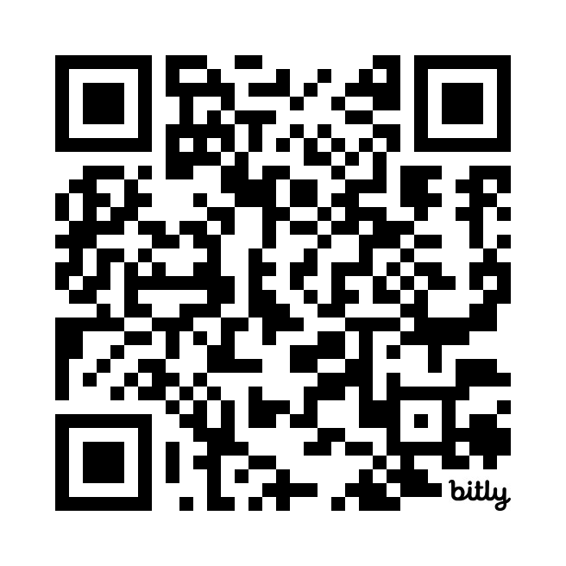
Week 4 Self-Test

Slide 52
Next Session (Week 5) November 27th, 2023
Building Routines

Slide 53
